Slide 1
Reminders + Electromagnetic oscillations + Electromagnetic waves

Slide 2
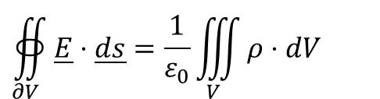
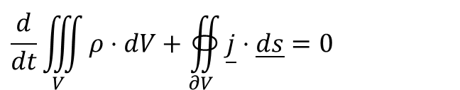
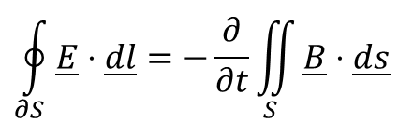
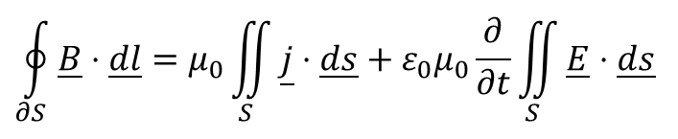
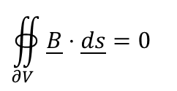
Reminder
$$∯_{∂V}{\underline{E}⋅\underline{ds}}=\frac{1}{ε_{0}}\iiint_{V}{ρ⋅dV}$$
Maxwell equations:
Continuity:
$$∯_{∂V}{\underline{B}⋅\underline{ds}}=0$$
$$\oint_{∂S}{\underline{E}⋅\underline{dl}}=−\frac{∂}{∂t}\iint_{S}{\underline{B}⋅\underline{ds}}$$
$$\oint_{∂S}{\underline{B}⋅\underline{dl}}=μ_{0}\iint_{S}{\underline{j}⋅\underline{ds}}+ε_{0}μ_{0}\frac{∂}{∂t}\iint_{S}{\underline{E}⋅\underline{ds}}$$
$$\frac{d}{dt}\iiint_{V}{ρ⋅dV}+∯_{∂V}{\underline{j}⋅\underline{ds}}=0$$

Slide 3
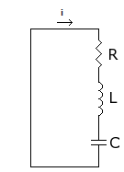
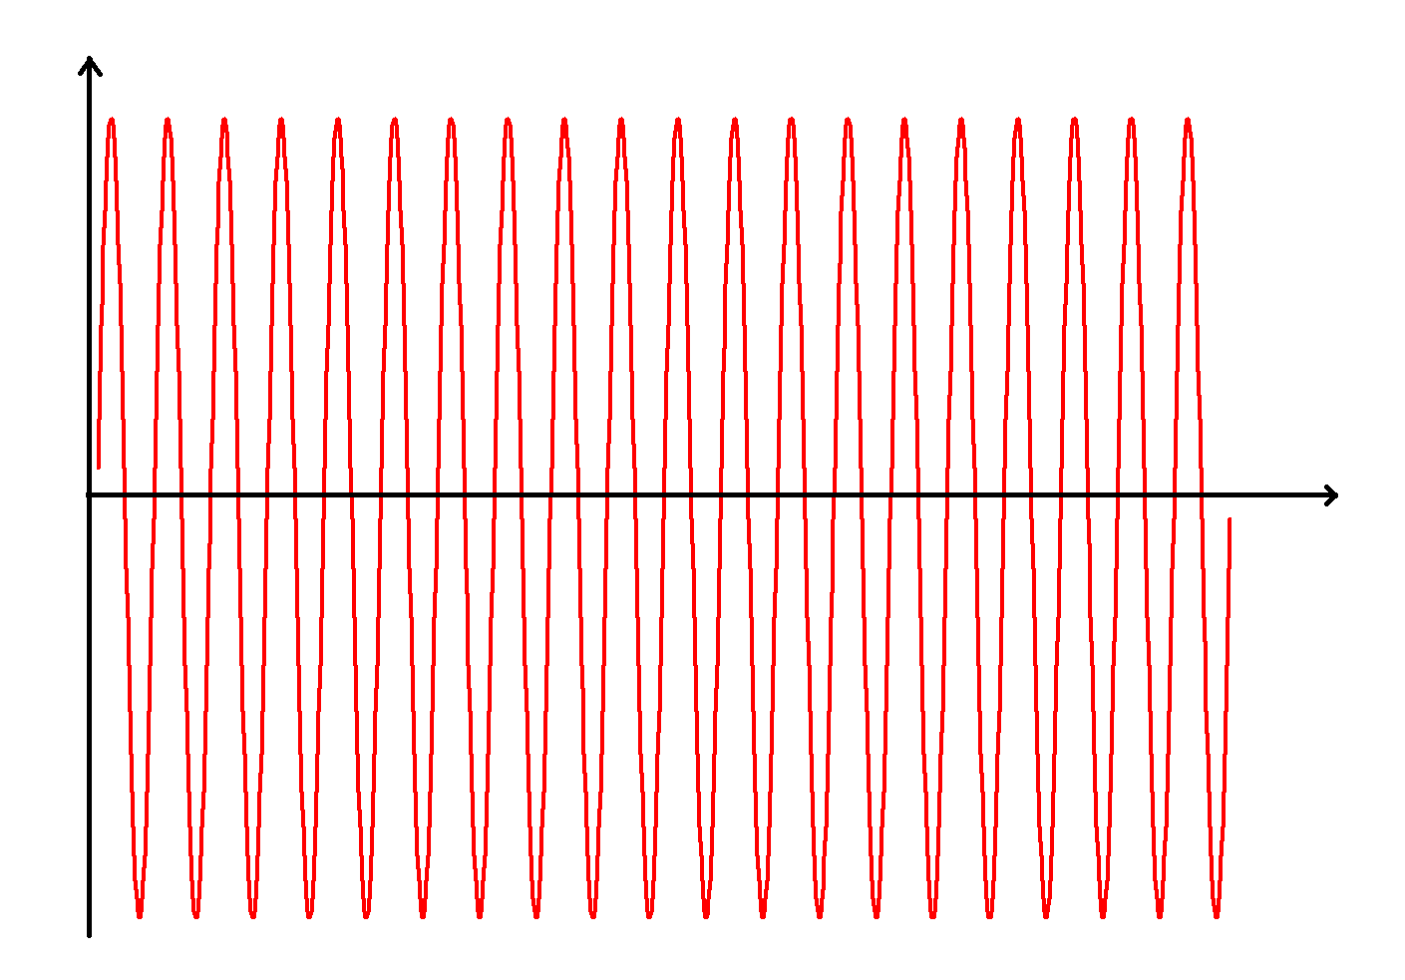
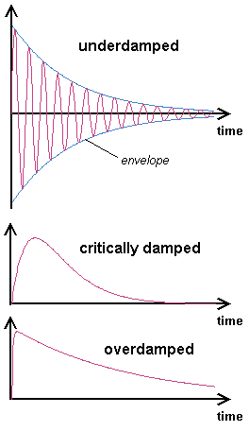
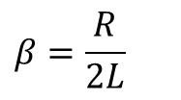
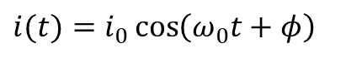
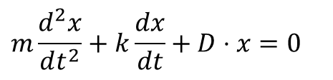
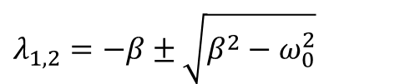
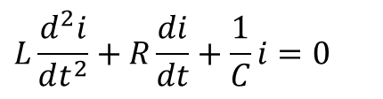
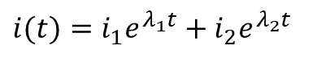
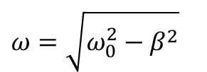
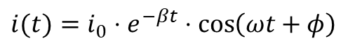
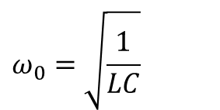
Reminder
$$L\frac{d^{2}i}{dt^{2}}+R\frac{di}{dt}+\frac{1}{C}i=0$$
$$m\frac{d^{2}x}{dt^{2}}+k\frac{dx}{dt}+D⋅x=0$$
L ↔ m
R ↔ k
1/C ↔ D
$$ω_{0}=\sqrt{\frac{1}{LC}}$$
$$i(t)=i_{0}\cos\left(ω_{0}t+φ\right)$$
$$i(t)=i_{0}⋅e^{−βt}⋅\cos\left(ωt+φ\right)$$
$$ω=\sqrt{ω_{0}^{2}−β^{2}}$$
$$β=\frac{R}{2L}$$
$$i(t)=i_{1}e^{λ_{1}t}+i_{2}e^{λ_{2}t}$$
$$λ_{1,2}=−β±\sqrt{β^{2}−ω_{0}^{2}}$$
Source of figures: http://www.wikipedia.org/
http://www.elmer.unibas.ch/

Slide 4
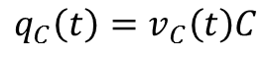
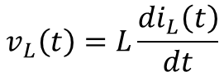
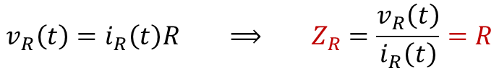
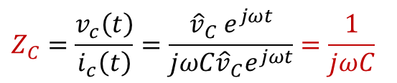
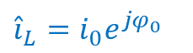
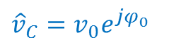
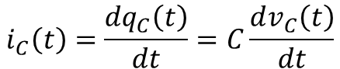
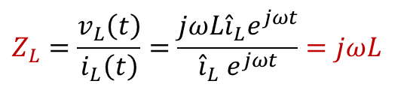
$$v_{R}\left(t\right)=i_{R}\left(t\right)R ⟹ Z_{R}=\frac{v_{R}\left(t\right)}{i_{R}\left(t\right)}=R$$
$$q_{C}\left(t\right)=v_{C}\left(t\right)C$$
$$i_{C}\left(t\right)=\frac{{dq}_{C}\left(t\right)}{dt}=C\frac{dv_{C}\left(t\right)}{dt}$$
$$v_{C}\left(t\right)={\hat{v}}_{C} e^{jωt} ⟹ i_{C}\left(t\right)=C\frac{d{\hat{v}}_{C} e^{jωt}}{dt}=C{\hat{v}}_{C} \frac{de^{jωt}}{dt}=jωC{\hat{v}}_{C}e^{jωt}$$
$$Z_{C}=\frac{v_{c}\left(t\right)}{i_{c}\left(t\right)}=\frac{{\hat{v}}_{C} e^{jωt}}{jωC{\hat{v}}_{C}e^{jωt}}=\frac{1}{jωC}$$
$${\hat{v}}_{C}=v_{0}e^{jφ_{0}}$$
$$v_{L}\left(t\right)=L\frac{{di}_{L}\left(t\right)}{dt}$$
$$i_{L}\left(t\right)={\hat{i}}_{L} e^{jωt} ⟹ u_{L}\left(t\right)=L\frac{d{\hat{i}}_{L} e^{jωt}}{dt}=L{\hat{i}}_{L} \frac{de^{jωt}}{dt}=jωL{\hat{i}}_{L}e^{jωt}$$
$$Z_{L}=\frac{v_{L}\left(t\right)}{i_{L}\left(t\right)}=\frac{jωL{\hat{i}}_{L}e^{jωt}}{{\hat{i}}_{L} e^{jωt}}=jωL$$
$${\hat{i}}_{L}=i_{0}e^{jφ_{0}}$$

Slide 5
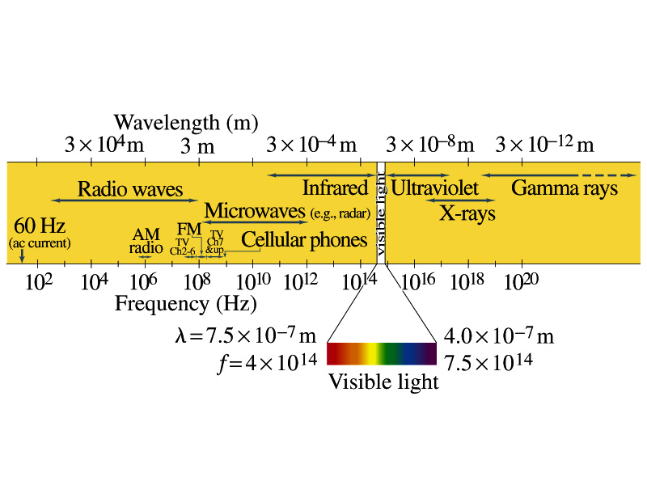
Reminder
Source of figure: http://www.phys.ttu.edu/~huang24/Teaching/Phys2401/

Slide 6
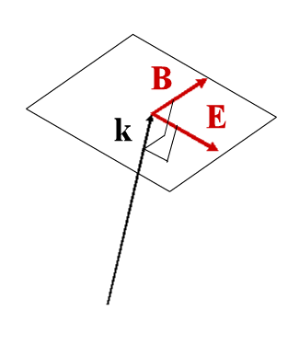
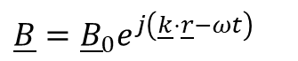
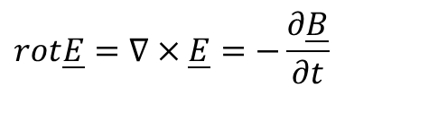
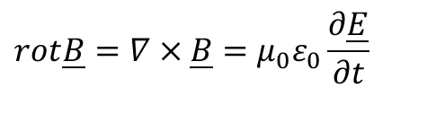
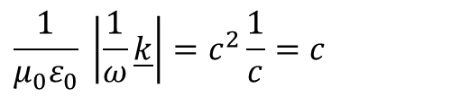
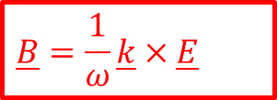
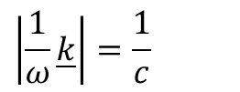
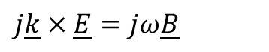
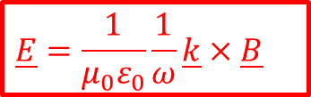
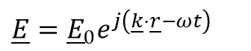
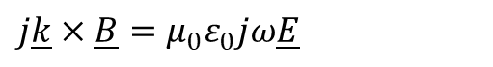
Reminder
$$\underline{E}={\underline{E}}_{0}e^{j\left(\underline{k}⋅\underline{r}−ωt\right)}$$
$$\underline{B}={\underline{B}}_{0}e^{j\left(\underline{k}⋅\underline{r}−ωt\right)}$$
$$rot\underline{E}=∇×\underline{E}=−\frac{∂\underline{B}}{∂t}$$
$$rot\underline{B}=∇×\underline{B}=μ_{0}ε_{0}\frac{∂\underline{E}}{∂t}$$
$$j\underline{k}×\underline{E}=jω\underline{B}$$
$$j\underline{k}×\underline{B}=μ_{0}ε_{0}jω\underline{E}$$
$$\underline{B}=\frac{1}{ω}\underline{k}×\underline{E}$$
$$\underline{E}=\frac{1}{μ_{0}ε_{0}}\frac{1}{ω}\underline{k}×\underline{B}$$
$$\left|\frac{1}{ω}\underline{k}\right|=\frac{1}{c}$$
$$\frac{1}{μ_{0}ε_{0}} \left|\frac{1}{ω}\underline{k}\right|=c^{2}\frac{1}{c}=c$$
Only in free space and isotropic medium
Source of figure: http://www.wepapers.com/Papers/9867/10-_Polarization%3B_Energy%2FPoynting%27s_Vector%3 B_Reflection_and_Refraction_at_a_Dielectric_Interface

Slide 7
Reminder
$$u_{E}=\frac{1}{2}ε_{0}E^{2}$$
$$u_{B}=\frac{1}{2μ_{0}}B^{2}$$
$$ΔU=ΔU_{E}+ΔU_{B}$$
$$ΔU=\frac{1}{2}L^{2}Δx\left(ε_{0}E_{y}^{2}+\frac{1}{μ_{0}}B_{z}^{2}\right)$$
$$E_{y}=cB_{z}$$
$$ΔU=\frac{1}{2}L^{2}Δx\left(ε_{0}cE_{y}B_{z}+\frac{1}{μ_{0}c}E_{y}B_{z}\right)=\frac{1}{2}L^{2}\frac{Δx}{c}E_{y}B_{z}\left(ε_{0}c^{2}+\frac{1}{μ_{0}}\right)$$
$$ΔU=L^{2}\frac{Δx}{c}E_{y}B_{z}\left(\frac{1}{μ_{0}}\right)$$
$$S=\frac{ΔU}{L^{2}Δt}=\frac{1}{μ_{0}}E_{y}B_{z}$$
$$\underline{S}=\frac{1}{μ_{0}}\underline{E}×\underline{B}$$
Source of figure: Hudson-Nelson: Útban a modern fizikához

Slide 8
Reminder
$${\underline{v}}_{d}=−\left[\frac{eE_{0}}{b}\sin\left(ωt\right)\right]{\underline{u}}_{y}$$
$${\underline{F}}_{E}=\left[−eE_{0}\sin\left(ωt\right)\right]{\underline{u}}_{y}$$
$$\frac{dU}{dt}={\underline{F}}_{E}⋅{\underline{v}}_{d}$$
$$\frac{dU}{dt}=\left[−eE_{0}\sin\left(ωt\right)\right]{\underline{u}}_{y}⋅\left[−\frac{eE_{0}}{b}\sin\left(ωt\right)\right]{\underline{u}}_{y}=\frac{e^{2}E_{0}^{2}}{b}\sin^{2}\left(ωt\right)$$
$$\frac{\text{dU}}{\text{dt}}=c\frac{e^{2}E_{0}B_{0}}{b}\text{si}{\text{n}}^{2}\left(\text{ωt}\right)=\text{c}{\text{F}}_{B}=c\frac{\text{dp}}{\text{dt}}$$
$$\int_{0}^{U}{\frac{dU}{dt}}=c\int_{0}^{p}{\frac{dp}{dt}}$$
$$U=cp$$
$$F=\frac{1}{c}\frac{dU}{dt}$$
$$P_{abs}=\frac{S}{c}$$
$$P_{refl}=\frac{2S}{c}$$

Slide 9
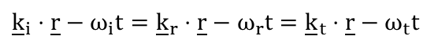
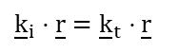
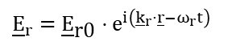
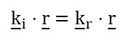
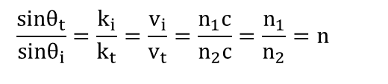
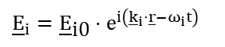
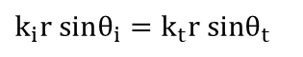
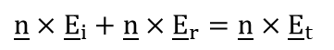
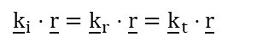
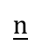
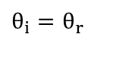
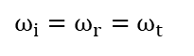
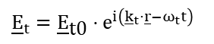


Reflection and transmission
$${\underline{E}}_{i}={\underline{E}}_{\text{i}\text{0}}⋅e^{i\left({\underline{k}}_{i}⋅\underline{r}−ω_{i}t\right)}$$
Tangential components shall be equal on both sides:
$$\underline{n}$$
$${\underline{E}}_{r}={\underline{E}}_{\text{r}\text{0}}⋅e^{i\left({\underline{k}}_{r}⋅\underline{r}−ω_{r}t\right)}$$
$$\underline{n}×{\underline{E}}_{i}+\underline{n}×{\underline{E}}_{r}=\underline{n}×{\underline{E}}_{t}$$
$$\underline{n}×{\underline{E}}_{\text{i}\text{0}}⋅e^{i\left({\underline{k}}_{i}⋅\underline{r}−ω_{i}t\right)}+\underline{n}×{\underline{E}}_{\text{r}\text{0}}⋅e^{i\left({\underline{k}}_{r}⋅\underline{r}−ω_{r}t\right)}=\underline{n}×{\underline{E}}_{\text{t}\text{0}}⋅e^{i\left({\underline{k}}_{t}⋅\underline{r}−ω_{t}t\right)}$$
The equation holds only if:
$${\underline{E}}_{t}={\underline{E}}_{\text{t}\text{0}}⋅e^{i\left({\underline{k}}_{t}⋅\underline{r}−ω_{t}t\right)}$$
$${\underline{k}}_{i}⋅\underline{r}−ω_{i}t={\underline{k}}_{r}⋅\underline{r}−ω_{r}t={\underline{k}}_{t}⋅\underline{r}−ω_{t}t$$
$$ω_{i}t=ω_{r}t=ω_{t}t$$
$$ω_{i}=ω_{r}=ω_{t}$$
At the origin →
At t = 0
$${\underline{k}}_{i}⋅\underline{r}={\underline{k}}_{r}⋅\underline{r}={\underline{k}}_{t}⋅\underline{r}$$
$${\underline{k}}_{i}⋅\underline{r}={\underline{k}}_{r}⋅\underline{r}$$
$${\underline{k}}_{i}⋅\underline{r}={\underline{k}}_{t}⋅\underline{r}$$
$$k_{i}\text{r} \text{sin}{\text{θ}}_{i}=k_{r}\text{r} \text{sin}{\text{θ}}_{r}$$
$$k_{i}\text{r} \text{sin}{\text{θ}}_{i}=k_{t}\text{r} \text{sin}{\text{θ}}_{t}$$
$$θ_{i}=θ_{r}$$
$$\frac{\text{sin}{\text{θ}}_{t}}{\text{sin}{\text{θ}}_{i}}=\frac{k_{i}}{k_{t}}=\frac{v_{i}}{v_{t}}=\frac{n_{1}c}{n_{2}c}=\frac{n_{1}}{n_{2}}=n$$

Slide 10


Optics
Huygens-Fresnel principle:
Source of figures: Hudson-Nelson: Útban a modern fizikához

Slide 11





Optics
Reflection:
$$AC=BD$$
$$α_{1}=α_{2}$$
$$θ_{i}=θ_{r}$$
Source of figures: Hudson-Nelson: Útban a modern fizikához

Slide 12











Snell’s law
$$v_{1}=\frac{c}{n_{1}}$$
$$v_{2}=\frac{c}{n_{2}}$$
$$t=\frac{CB}{v_{1}}$$
$$t=\frac{AN}{v_{2}}$$
$$v_{2}CB=v_{1}AN$$
$$\frac{c}{n_{2}}CB=\frac{c}{n_{1}}AN$$
$$n_{1}CB=n_{2}AN$$
$$n_{1}\sin{θ_{1}}=n_{2}\sin{θ_{2}}$$
$$CB=AB\sin{θ_{1}}$$
$$AN=AB\sin{θ_{2}}$$
Source of figure: www.wikipedia.org

Slide 13
Optics
Fermat principle:
O
I
S

Slide 14








Spherical mirror
P
$$β=γ+θ$$
$$β=α+2θ$$
$$α≈\frac{h}{OM}$$
$$β≈\frac{h}{IM}$$
$$γ≈\frac{h}{CM}$$
$$α+β=2γ$$
$$\frac{1}{OM}+\frac{1}{IM}=\frac{2}{CM}$$
Source of figure: Hudson-Nelson: Útban a modern fizikához

Slide 15





Spherical mirror
P
$$θ=γ+β$$
$$α=θ+γ$$
$$α≈\frac{h}{OM}$$
$$β≈\frac{h}{IM}$$
$$γ≈\frac{h}{CM}$$
$$α−β=2γ$$
$$\frac{1}{OM}−\frac{1}{IM}=\frac{2}{CM}$$
Source of figure: Hudson-Nelson: Útban a modern fizikához

Slide 16





Spherical mirror
P
$$θ=α+γ$$
$$2θ=α+β$$
$$α≈\frac{h}{OM}$$
$$β≈\frac{h}{IM}$$
$$γ≈\frac{h}{CM}$$
$$α−β=−2γ$$
$$\frac{1}{OM}−\frac{1}{IM}=−\frac{2}{CM}$$
Source of figure: Hudson-Nelson: Útban a modern fizikához

Slide 17



Spherical mirror
$$\frac{1}{∞}−\frac{1}{f}=\frac{2}{R}$$
$$f=\frac{R}{2}$$
Source of figure: Hudson-Nelson: Útban a modern fizikához

Slide 18


Spherical mirror
$$\frac{1}{o}+\frac{1}{i}=\frac{1}{f}$$
$$f=\frac{R}{2}$$
o > 0 if incident beams are divergent
i > 0 if reflected beams are convergent
f > 0 if the mirror is concave
Source of figure: Hudson-Nelson: Útban a modern fizikához

Slide 19

Spherical mirror
A
D
C
B
E
Source of figure: www.wikipedia.org

Slide 20

Spherical mirror
Source of figure: www.wikipedia.org

Slide 21

Spherical mirror
Source of figure: www.wikipedia.org

Slide 22

Spherical mirror
Source of figure: www.wikipedia.org

Slide 23

Spherical mirror
Source of figure: www.wikipedia.org

Slide 24

Spherical mirror
Source of figure: www.wikipedia.org

Slide 25

Reminder: Snell’s law
$$v_{1}=\frac{c}{n_{1}}$$
$$v_{2}=\frac{c}{n_{2}}$$
$$t=\frac{CB}{v_{1}}$$
$$t=\frac{AN}{v_{2}}$$
$$v_{2}CB=v_{1}AN$$
$$\frac{c}{n_{2}}CB=\frac{c}{n_{1}}AN$$
$$n_{1}CB=n_{2}AN$$
$$n_{1}\sin{θ_{1}}=n_{2}\sin{θ_{2}}$$
$$CB=AB\sin{θ_{1}}$$
$$AN=AB\sin{θ_{2}}$$
Source of figure: www.wikipedia.org

Slide 26







Total internal reflection
$$n_{1}\sin{θ_{1}}=n_{2}\sin{θ_{2}}$$
$$θ_{2}$$
If n₁ > n₂ and θ₂ = 90°
$$n_{1}\sin{θ_{1}}=n_{2}$$
$$θ_{1}′$$
$$θ_{1}=\arcsin{\frac{n_{2}}{n_{1}}}$$
$$θ_{1}$$
Source of figure: www.wikipedia.org

Slide 27

Total reflection
Source of figures: www.wikipedia.org

Slide 28

Snell’s window
Source of figure: http://www.uwphotographyguide.com/underwater-photography-snell039s-window

Slide 29


Total reflection
Source of figures: www.wikipedia.org

Slide 30

Prism
Source of figure: www.wikipedia.org

Slide 31

Spherical lenses
Source of figure: www.wikipedia.org

Slide 32








Spherical lenses
P₁
θ₁
P₁
θ₂
α
γ
β
O
C
R
I
$$θ_{1}=α+γ$$
$$γ=θ_{2}+β$$
$$n_{1}θ_{1}=n_{1}α+n_{1}γ$$
$$n_{2}θ_{2}=n_{2}γ−n_{2}β$$
$$n_{1}α+n_{1}γ=n_{2}γ−n_{2}β$$
$$n_{1}α+n_{2}β=\left(n_{2}−n_{1}\right)γ$$
$$\frac{n_{1}}{OC}+\frac{n_{2}}{IC}=\frac{n_{2}−n_{1}}{RC}$$
$$\frac{n_{1}}{o}+\frac{n_{2}}{i_{1}}=\frac{n_{2}−n_{1}}{R_{1}}$$

Slide 33











Spherical lenses
$$\frac{n_{1}}{o}+\frac{n_{2}}{i_{1}}=\frac{n_{2}−n_{1}}{R_{1}}$$
ϕ₁
P₂
n₁
n₂
ϕ₂
$$φ_{1}=γ_{2}+β_{2}$$
$$φ_{2}=γ_{2}+α_{2}$$
γ₂
h
β₂
α₂
$$n_{1}β_{2}−n_{2}α_{2}=\left(n_{2}−n_{1}\right)γ_{2}$$
i
R₂
i₁
$$\frac{n_{1}}{i}−\frac{n_{2}}{i_{1}}=\frac{n_{2}−n_{1}}{R_{2}}$$
$$α_{2}≈tgα_{2}=h/i_{1}$$
$$β_{2}≈tgβ_{2}=h/i$$
$$\frac{n_{1}}{o}+\frac{n_{1}}{i}=\left(n_{2}−n_{1}\right)\left(\frac{1}{R_{1}}+\frac{1}{R_{2}}\right)$$
$$γ_{2}≈tgγ_{2}=h/R_{2}$$
$$n≡\frac{n_{2}}{n_{1}}$$
$$\frac{1}{o}+\frac{1}{i}=\left(n−1\right)\left(\frac{1}{R_{1}}+\frac{1}{R_{2}}\right)$$

Slide 34



Spherical lenses
$$\frac{1}{o}+\frac{1}{i}=\frac{1}{f}$$
$$\frac{1}{f}=\left(n−1\right)\left(\frac{1}{R_{1}}+\frac{1}{R_{2}}\right)$$
Source of figure: www.wikipedia.org

Slide 35

Spherical lenses
Source of figure: www.wikipedia.org

Slide 36
Spherical lenses
Source of figure: www.wikipedia.org

Slide 37

Spherical lenses
Source of figure: www.wikipedia.org

Slide 38

Spherical lenses
Source of figure: www.wikipedia.org

Slide 39

Refractors
Galilei telescope
D = F + (-f)
Kepler telescope
D = F + t
Source of figure: http://tudasbazis.csillagaszat.hu/tavcsovek/lencses-tavcsovek.html

Slide 40


Reflectors
Newton telescope
Cassegrain telescope
Source of figure: www.wikipedia.org

Slide 41

Spherical aberration
Source of figure: www.wikipedia.org

Slide 42

Spherical aberration
Source of figure: www.wikipedia.org

Slide 43

Coma (comatic aberration)
Source of figure: www.wikipedia.org

Slide 44

Coma (comatic aberration)
Source of figure: http://www.ryokosha.com/eng/products/nh_3ma.html

Slide 45

Chromatic aberration
Source of figure: www.wikipedia.org

Slide 46

Chromatic aberration
Source of figure: www.wikipedia.org

Slide 47

Astigmatism
Source of figure: www.wikipedia.org

Slide 48

Astigmatism
Source of figure: www.wikipedia.org

Slide 49

Field curvature
Source of figure: www.wikipedia.org

Slide 50

Source of figure: www.wikipedia.org

Slide 51


Slide 52



Double slit experiment
Source of figures: www.wikipedia.org

Slide 53

Double slit experiment
Source of figure: www.wikipedia.org

Slide 54


Slide 55



Double slit experiment
$$φ=2π⋅\frac{Δr}{λ}$$
$$Δr=d⋅\sin{θ}$$
Coherence: two waves are coherent if
thier wavelengths are the same
the phase difference does not change in time
Source of figure: Hudson-Nelson: Útban a modern fizikához

Slide 57











Double slit experiment
$$E_{3}=E_{1}+E_{2}=E_{0}⋅\sin\left(ωt\right)+E_{0}⋅\sin\left(ωt+φ\right)$$
$$Δr=d⋅\sin{θ}$$
$$E_{3}=2E_{0}⋅\cos\left(\frac{φ}{2}\right)\sin\left(ωt+\frac{φ}{2}\right)$$
$$φ=2π⋅\frac{Δr}{λ}$$
$$I\sim {\left[2E_{0}⋅\cos\left(\frac{φ}{2}\right)\right]}^{2}=4E_{0}^{2}⋅\cos^{2}\left(\frac{φ}{2}\right)$$
$$I=I_{0}⋅\cos^{2}\left(\frac{φ}{2}\right)$$
$$mλ=d⋅\sin{θ}$$
$m∈ℤ ⟹$ Bright
$$\left(m+\frac{1}{2}\right)λ=d⋅\sin{θ}$$
$m∈ℤ ⟹$ Dark
Source of figure: Hudson-Nelson: Útban a modern fizikához

Slide 58


Coherence
Two waves are coherent if
thier wavelengths are the same
the phase difference does not change in time
Temporal coherence describes the correlation between signals observed at different moments in time.
Spatial coherence describes the correlation between signals at different points in space.
Source of figures: www.wikipedia.org

Slide 59

Multiple slits
Source of figure: Hudson-Nelson: Útban a modern fizikához

Slide 60






Multiple slits
Source of figure: Hudson-Nelson: Útban a modern fizikához

Slide 61




Multiple slits
$$mλ=d⋅\sin{θ}$$
2
5
150
Source of figures: Hudson-Nelson: Útban a modern fizikához
www.wikipedia.org

Slide 62

Fraunhofer diffraction
Source of figure: Hudson-Nelson: Útban a modern fizikához

Slide 63






Fraunhofer diffraction
$$\frac{Δl}{λ}=\frac{Δφ}{2π}$$
$$\frac{Δy\sin{θ}}{λ}=\frac{Δφ}{2π}$$
$$Δφ=\frac{2π}{λ}Δy\sin{θ}$$
$$φ=\frac{2π}{λ}a⋅\sin{θ}$$
$$E_{θ}=2R\sin\left(\frac{φ}{2}\right)$$
Source of figure: Hudson-Nelson: Útban a modern fizikához

Slide 64








Fraunhofer diffraction
$$E_{θ}=2R\sin\left(\frac{φ}{2}\right)$$
$$φ=\frac{2π}{λ}a⋅\sin{θ}$$
$E_{0}=Rφ ⟹ R=\frac{E_{0}}{φ}$
$$E_{θ}=\frac{2E_{0}\sin\left(\frac{φ}{2}\right)}{φ}=E_{0}\left(\frac{\sin{α}}{α}\right)$$
$$α=\frac{π}{λ}a⋅\sin{θ}$$
$$I_{θ}=I_{0}{\left(\frac{\text{sinα}}{α}\right)}^{2}$$
$$α=mπ$$
$$mλ=a\sin{θ}$$
Source of figure: Hudson-Nelson: Útban a modern fizikához

Slide 65
Fraunhofer diffraction
Source of figure: Hudson-Nelson: Útban a modern fizikához

Slide 66

Source of figure: www.wikipedia.org

Slide 67



Rayleigh criterion
$$D\sin{θ}=p_{m}λ$$
$$θ_{R}=\frac{1.22λ}{D}$$
Source of figure: Hudson-Nelson: Útban a modern fizikához

Slide 68

The Very Large Telescope of the European Southern Observatory in the Atacama Desert
Source of figure: www.wikipedia.org

Slide 69





Different materials
$$λ_{n}=\frac{λ}{n}$$
$$\frac{b}{\left(\frac{λ}{n}\right)}=n\frac{b}{λ}$$
$$\frac{nb}{λ}−\frac{b}{λ}=\frac{b}{λ}\left(n−1\right)$$
$$φ=2π\frac{b}{λ}\left(n−1\right)$$
Source of figure: Hudson-Nelson: Útban a modern fizikához

Slide 70

Oil on water
Source of figure: http://startalkastro.com/blog/?p=94

Slide 71

Reflection from thin layers
Source of figure: http://hyperphysics.phy-astr.gsu.edu/hbase/phyopt/interf.html#c1

Slide 72




Reflection from thin layers
Source of figures: http://hyperphysics.phy-astr.gsu.edu/hbase/phyopt/oilfilm.html#c1
http://hyperphysics.phy-astr.gsu.edu/hbase/phyopt/soapfilm.html#c1

Slide 73

Anti-reflection coatings
Source of figure: http://hyperphysics.phy-astr.gsu.edu/hbase/phyopt/antiref.html#c1

Slide 74

Anti-reflection coatings
Source of figure: http://hyperphysics.phy-astr.gsu.edu/hbase/phyopt/antiref.html#c1

Slide 75

Newton rings
Source of figure: http://spie.org/x32482.xml

Slide 76


Null corrector
Source of figure: www.wikipedia.org

Slide 77

Michelson interferometer
Source of figure: http://kspark.kaist.ac.kr/Twin%20Paradox/Relativity%20Facts.files/Michelson%20interferometer.gif

Slide 78



Michelson interferometer
$$mλ=2d⋅\cos{θ}$$
Source of figure: Hudson-Nelson: Útban a modern fizikához
www.wikipedia.org

Slide 79



Phase velocity, group velocity
Velocity of a point of a given phase:
$$\underline{E}={\underline{E}}_{0}⋅e^{i\left(\underline{k}⋅\underline{r}−ωt\right)}$$
$$\underline{k}⋅\underline{r}−ωt=φ$$
$${\underline{v}}_{ph}=\frac{d\underline{r}}{dt}=\frac{ω}{\left|\underline{k}\right|}⋅\frac{\underline{k}}{\left|\underline{k}\right|}=\frac{c}{n_{r}}⋅\frac{\underline{k}}{\left|\underline{k}\right|}$$

Slide 80




Phase velocity, group velocity
Superposition of two waves of slightly different frequency:
$$u(x,t)=U\sin\left(kx−ωt\right)+U\sin\left(k′x−ω′t\right)$$
$$\sin{α}+\sin{β}=2\sin{\frac{α+β}{2}}\cos{\frac{α−β}{2}}$$
$$u(\text{x}\text{,}\text{t})=\text{2}\text{Ucos}\frac{1}{2}\left[\left(\text{k}\text{′}−k\right)x−\left(\text{ω}\text{′}−ω\right)t\right]\text{sin}\frac{1}{2}\left[\left(\text{k}\text{′}+k\right)x+\left(\text{ω}\text{′}+ω\right)t\right]$$
$$u(x,t)=2U\cos{\frac{1}{2}}\left[\left(k′−k\right)x−\left(ω′−ω\right)t\right]\sin\left(kx−ωt\right)$$
$$v_{g}=\frac{ω′−ω}{k′−k}=\frac{dω}{dk}$$
v_{g} : group velocity
v : phase velocity
Source of figure: www.wikipedia.org

Slide 81


Wave packet
Source of figures: http://hyperphysics.phy-astr.gsu.edu/hbase/waves/wpack.html
http://scienceblogs.com/principles/2007/03/basic_concepts_measurement.php

Slide 82






$$\hat{f}\left(ν\right)=ℱ\left(f\left(t\right)\right)=\int_{−∞}^{∞}{f\left(t\right)e^{−2πjtν}dt}$$
$$f\left(t\right)=\frac{1}{\sqrt{2π}σ_{t}}e^{−\frac{t^{2}}{2σ_{t}^{2}}}$$
$$\hat{f}\left(ν\right)=\int_{−∞}^{∞}{\frac{1}{\sqrt{2π}σ_{t}}e^{−\frac{t^{2}}{2σ_{t}^{2}}}e^{−2πjtν}dt}$$
$$\hat{f}\left(ν\right)=e^{−2π^{2}σ_{t}^{2}ν^{2}}$$
f’$\left(t\right)=ℱ\left(\hat{f}\left(ν+ν_{0}\right)\right)=\frac{1}{\sqrt{2π}σ_{ν}}e^{−\frac{t^{2}}{2σ_{t}^{2}}}e^{−2πjtν_{0}}$
$$σ_{t}σ_{ν}=\frac{1}{2π}$$

